Slide 1


ADVANCED MODELLING FOR OPERATIONS ASSIGNMENT 1
Almir Gungor 10752670
Berk Ceyhan 10761821
Cagatay Onur 10781315
Lorenzo Ghedini 10586137

Slide 2

TABLE OF CONTENTS
Weaknesses of the Base Case
Routing
Charging
Base Charging Policy vs New Charging Policy
New Charging Policy
Charging Station Selection
Charging Station Selection Probability Calculations
Charging Station Selection Output
Charging Amount
When to Charge?
Base Case Charging Policy vs New Charging Policy Performances
Battery Size
Capacity of the Vans
Stochastic Speed
The Number of Vans Needed
Conclusion
2

Slide 3



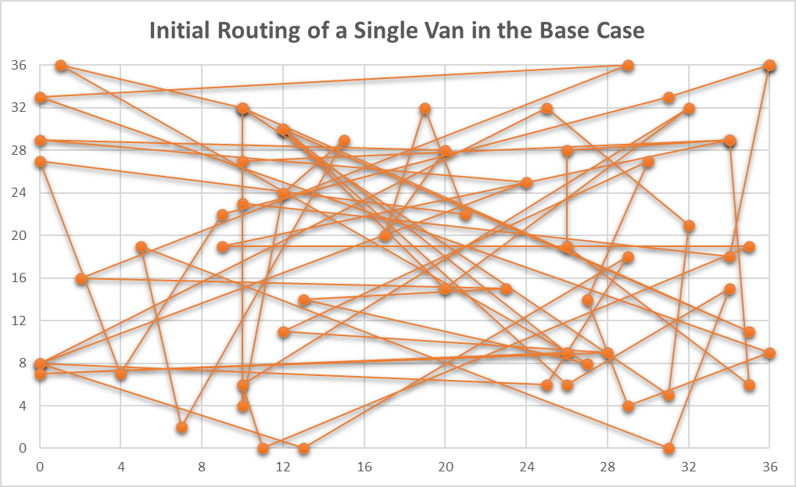











WEAKNESSES OF THE BASE CASE
The following points are the major weaknesses of the base case. They are improved in the project work.
Routing Policy: There is no routing in the base case. Van just follows the order of customer index. Also, it is not possible to get routings for multiple vans. For optimizing the number of vans to deliver to each customer in the required timeslot, this project work offers a routing policy. The improved version will be explained in slides [5:7].
Charging Policy: In the base case, when charging is required, van goes to the closest charging station. This is not so desirable because the waiting time at the closing charging station might be very high. We provided a new charging policy, choosing the most convenient charging station. The improved version will be explained in slides [8:16]
Speed of Vans: To take an average deterministic speed is not sufficient to simulate the real-life problem. In order to make it more realistic, the speed can be converted to a stochastic speed. The improved version will be explained in slide 19.
Battery Size: In the base case, the same battery size is assumed to be fixed for all the vans. According to the routings, the required battery size for each van might differ. Thanks to a further calculation of the required battery sizes, the company can be more flexible in renting trucks. For example, a company can rent a more expensive truck (with a bigger battery) for the routing of 126 km while a less expensive truck (with a smaller battery) is sufficient for a routing of 96km. This can be a possible saving for the company. The improved version will be explained in slide 17.
25 kwh
35 kwh
Weight Capacity of the Vans and Weight of the Loads: Both may affect the customer allocation to the vans and the energy consumed at any moment. Customer allocation might be affected because of the maximum number of orders carried in a van. With a domino effect, they might affect the tour time and even the number of vans required. In the description of the assignment, average order weight is given but not implemented in the base case. Yet, in the solution the weight capacity of the vans and average weight of the loads are implemented. This way, routings and energy usage values will be more accurate. Furthermore, the solution can even be improved by adding stochasticity to the average order weight. The improved version will be explained in slide 18.
3

Slide 4




WEAKNESSES OF THE BASE CASE
The following points are the minor weaknesses of the base case. They are not implemented in the new version of the model. In fact, neglecting these aspects is logical, considering the scope of the project, and the fact that implementing them will not bring a major gain. However, they are worth being kept in mind.
Space capacity of the vans: Average order volume can affect the customer allocation to each van because of the limitations of the number of orders carried by a van. It was not given as a parameter in the description of the assignment. If it is given, it can also be implemented. This can be implemented by generating the orders as an attribute of the agent “customer” by defining their weight and their volume at the start of the simulation and defining the customer allocation and routing according to it. This idea is not implemented in our model.
«Customers» can be another agent: They might have behaviours depending on the arrival time of vans. For example, they may have a desired delivery time and they may cancel the order if the van is late. This can represent the real-world situation better. This idea is not implemented in our model.
External arrivals of the cars to the charging stations with 1/45 uniform distribution The arrival frequency of external cars is a “fixed” probability in the base case. In a real world where the agents make rational decisions, a charging station with a short queue has a higher probability of being occupied by other cars such as with 1/30 uniform distribution. Modelling other cars also as agents who can observe the current waiting times of the charging stations and make decisions accordingly could represent the real-world situation better. This idea is not implemented in our model.
Free charging station !
Queue=0
4

Slide 5
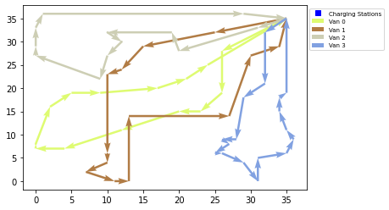
ROUTING
The routing issue was considered as a “multiple travelling salesman problem”. Two major approaches were followed during solution:
Optimal routes for each van: The total distance travelled by each van is minimized. This approach needs to be combined with the following approach to improve the solution from one van to multiple vans case.
Minimum longest distance travelled amongst vans: The total distance travelled by the van which travelled the most needs to be minimized in order to have a final picture where all the vans can travel similar distances. This will help the optimization of the routing, by balancing the route distance travelled by each van.
The figure on the right represents the visualization of the routing of the optimal case.
To determine this optimal routing for each van, “ortools.constraint_solver” library is used. This library was used since it consists of some interesting tools to solve the multiple travelling salesman problem. From this library, “routing_enums_pb2” and ”pywrapcp” were imported since they are the elements responsible to import the constraints programming solver. Once imported, these two elements are responsible for finding the best solution of the routing problem. Running the simulation for an increasing number of vans is possible to see that for the solver the best solution correspond to the routing computed with 4 Vans, which has the minimum longest route of 126 km. According to the solver this is the best solution possible because also increasing the number of the vans the minimum longest route will be the same or even higher and so if the number of Van increases for the solver the solution will remain the same and so one or more vans will remain at the warehouse and just 4 will move. Of course the routing obtained in this way has some important limitations because it does the computation just in function of the distance and so it does not take into consideration the charging of the van or the fact that the velocity may be stochastic. For these reason we have to verify that this is effectively a good routing for our problem, by running multiple simulations.
5
Reference: https://developers.google.com/optimization/routing/vrp?hl=tr

Slide 6
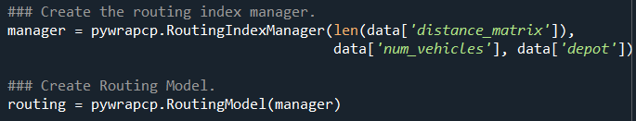
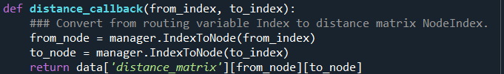
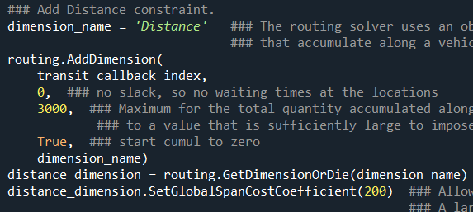
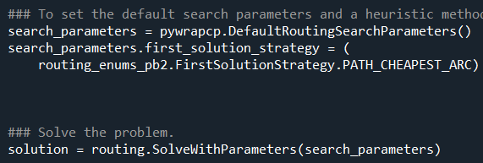
ROUTING
The solution is reached by defining the following functions.
Main (Python Script Section 4.4):
The main function is used to control the routing solution. It starts by taking data which is created by the function “create data model” and define two variables “manager” and “routing“ to simplify the variable index usage.
Then, it is necessary to define the distances between each customer location to use in the decision process for the optimal routings. For that, a “distance callback” function is defined.
In this part, there is also the “arc costs” which define the cost of travel to be the distances of the arcs. In this way, the best routing can be defined by first creating a “distance dimension” which computes the cumulative distance traveled by each vehicle along its route. Then, a cost proportional to the maximum of the total distances along each route is set. In this part, a large coefficient (200) is chosen for the global span of the routes, which is the maximum of the distances of the routes. This makes the global span the predominant factor in objective function, so the program minimizes the length of the longest route.
Lastly before the solution, we have the “search parameters” in which the solver define the default search parameters from which we can define a heuristic method for finding the first solution of the problem through ”path cheapest arc” which creates an initial route for the solver by repeatedly adding edges with the least weight that doesn't lead to a previously visited node (other than the depot).
Once this initial routing is defined, it is possible to call the solver in order to return the solution and displays the optimal route
6
Reference: https://developers.google.com/optimization/routing/vrp?hl=tr

Slide 7
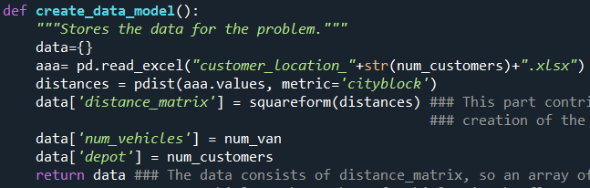
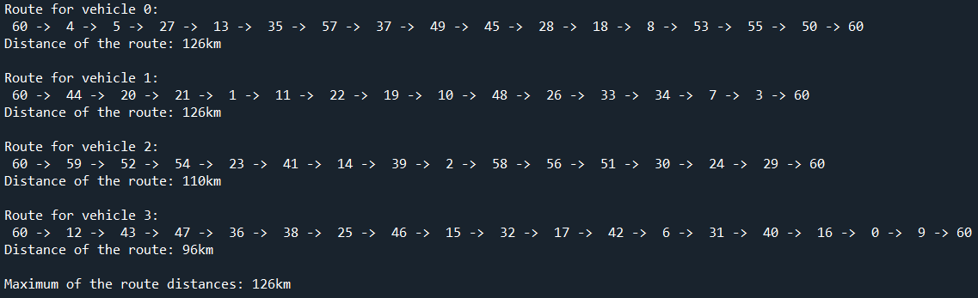
ROUTING
create_data_model (Python Script Section 4.1): This function represents the data preparation part. Data is gathered as a matrix in which all the travel distance between the costumers and warehouse will be included as well as the number of customers, the number of vans and the starting point for the routing the warehouse.
distance_callback (Python Script Section 4.4.2) of the indexes, manager.IndexToNode is used to define the from and to nodes.
get_routes (Python Script Section 4.3): This function is utilized to save the routes to a list or array. This has the advantage of making the routes available for the successive parts
print_solution (Python Script Section 4.2): This function is responsible for the display of the routes and the computation of the total distance travelled by the vans. The following is the output of the function.
7

Slide 8

CHARGING: Base Charging Policy vs New Charging Policy
The new charging policy has 3 main pillars, that will be explained in the following slides in detail: Charging Station Selection, Charging Amount and When to Charge.
BASE CHARGING POLICY
1.Charging Station Selection
Go to the closest charging station.
Weakness 1: The closest station can have a very long queue, making it a relatively worse option.
NEW CHARGING POLICY
1.Charging Station Selection
Go to the best charging station which is determined by calculating charging station scores for each single charging station by considering:
. Current position of the vans
. The current waiting times and locations of the charging stations
. The location of the next customer
!!! NOTE: Since different vans have different current positions, the charging station scores will be different for different vans (e.g. a charging station close to a van will have probably a better score for that given van). This issue will be deepened in the following sections.
Advantage 1: The van will choose the most convenient charging station, not necessarily the closest one.
2.Charging Amount
Calculate extra needed energy in advance, depending on the route distance calculated at the beginning, and charge this extra needed energy.
For example:
Total travel energy needed= 28 kwh Battery size= 25kwh
Extra needed energy= (Total travel energy needed - Battery size) * safety = (28-25)*1.15 = 3.45 kwh
Advantage 2: The van will save time by eliminating unneccesary charging time, and also eliminating multiple charging due to the charging amount is calculated in advance
3.When to Charge?
When there is enough space in the battery to charge extra needed energy, start searching for good alternatives. The van will have the chance of postponing the charging until a good alternative is available.
For example :
Battery size= 25kwh Extra needed energy= 3.45 kwh
When battery level<=battery size-extra energy need=25-3.45=21.55 kwh start searching for a station
Advantage 3: The van will have more chance to optimize the charging station selection.
2.Charging Amount
Charging 20% (fixed) of the battery size
Weakness 2: 20% may be too much or too little. If it needs more than 20%, it will spend unneccessary time for charging for a second time. If the van needs less than 20%, it will spend unneccessary time charging excessive amount of battery.
3.When to Charge?
Monitor the battery level, and go charging when it is at the critical level (the battery about to die)
Weakness 3: In this way, the van misses many good opportunities (free charging stations) along the route. Being forced to charge only at the critical level, it may be forced to make a poor decision of going to a charging station with a very long queue.
8

Slide 9
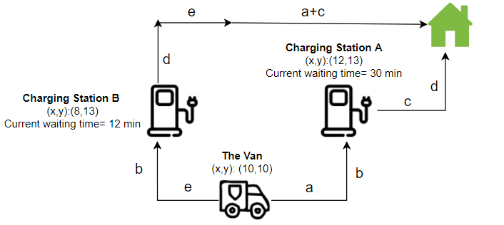
CHARGING: New Charging Policy: Charging Station Selection
The main objective of new charging policy is to calculate the charging station score
Example Case:
Next customer
(x,y):(15,15)
Charging Station Score =
Expected Waiting Time in the Queue + Extra Travel Time
Expected Waiting Time [EWT]:
This score is determined by making probability calculations using:
*Current Waiting Times at the charging stations [CWT]
*Distance to arrive a charging station [DA]
*Time to arrive to a charging station [TTT]=[DA]/speed
*Probability of an external vehicle arriving before our van 1/45 uniform dist. (Will be explained in slide 11)
* Mean charging time of external vehicles 25 min
The LOWER this score, the BETTER option it is
Charging Station A
EWT A = (CWT – TTT) + (TTT/45 * 25)
= (30-10)+(10/45)*25 = 25.55 min
Note: TTT= DA/(30km/h)=5 km/(30km/h)= 10 min
Charging Station B
EWT A = (CWT – TTT) + (AT * TTT * CTE)
= (12-10)+(10/45)*25 = 7.55 min
Note: TTT= DA/(30km/h)=5 km/(30km/h)= 10 min
Extra Travel Time [ETT]:
This score is penalizing the charging stations which increase the travelled distance.
The LOWER this score, the BETTER option it is.
ETT B = ((a+b+c+d)-(a+b+c+d))/(30km/h) = 0 min
Going to A does not cost anything in terms of distance, because it is located in between the van’s location and the next customer’s location (in the no-cost zone).
ETT B = ((a+b+c+d+2*e)-(a+b+c+d))/(30km/h) = 2*e/(30km/h)=8 min
Going to B costs extra 8 min to the van.
Charging Station Score [CSS]:
The LOWER this score, the BETTER option it is.
CSS A = 0 + 25.55 = 25.55 min
CSS B = 8 + 7.55 = 15.55 min
9
CONCLUSION: Choose B
(lower charging station score)
(See slides 10,11,12,13 for detailed explanations)

Slide 10
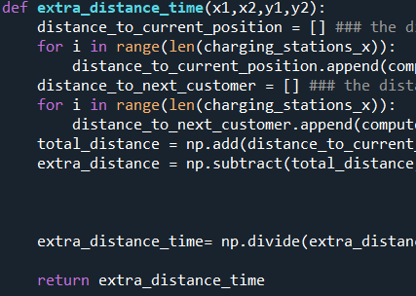
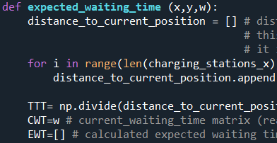

CHARGING: New Charging Policy: Charging Station Selection
The script for calculations are explained in this section.
Extra Travel Time (Script Section: 5.1)
(x1,y1): Coordinates of the van
(x2,y2): Coordinates of the next customer
distance_to_current_position: The array containing the distances of the charging stations to the current position of a van
distance_to_next_customer: The array containing the distances of the charging stations to the location of the next customer
total_distance= distance_to_current_position + distance_to_next_customer
extra_distance= total_distance - (Distance between the van and the customer)
extra_distance_time= converting extra_distance to time
Expected Waiting Time (Slide 11 for detailed explanations) (Script Section: 5.2)
distance_to_current_position: The array containing the distances of the charging stations to the current position of a van
TTT: Converting distance_to_current_position to time
CWT: Current waiting times of the charging stations
EWT: Expected waiting time to calculate for each single charging station
Charging_station_score (Script Section: 5.3)
best_station_id (Script Section: 5.4)
(x1,y1): Coordinates of the van
(x2,y2): Coordinates of the next customer
w: current waiting time matrix of the charging stations
charging_station_score = extra_distance_time + expected_waiting time
Note: Calculating charging_station_score is the main objective of these calculations.
The van will choose the charging station with THE LOWEST charging station score.
This function gets the id of the charging station with the lowest charging_station_score.
This id will be used to make the van go to that specific charging station.
10

Slide 11
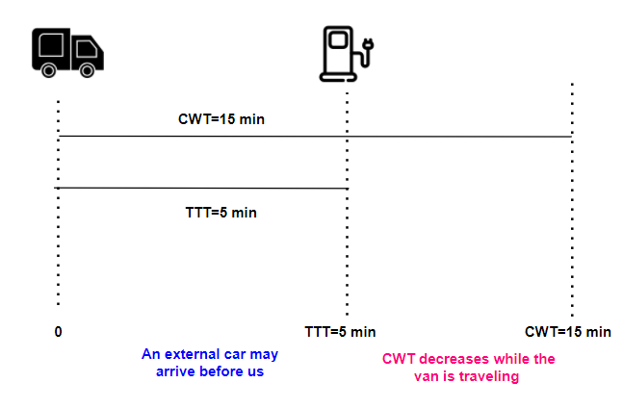



CHARGING: New Charging Policy: Charging Station Selection Probability Calculations
(Python Script 5.2)
The best charging station is chosen, and the van starts to go there. It would be shame if another car goes to the charging station before our van! The longer the time passes until the van reaches the station, the more the risk of another car reaching before our van. So, the probability of an external car arriving before us is a crucial factor that needs to be calculated. It is calculated and added in the calculation of EWT. The section explains the corresponding concept and the script.
Example for Formula 1
Formula 1:
EWT= CWT-TTT+ TTT/45 * 25
CWT-TTT: Waiting time caused by current queue. We substract TTT, because while the van is travelling to that charging station, the current waiting time will decrease by TTT
TTT/45: The expected value of the cars arriving before our van arrives. Multiplying this by 25 will give us expected increase of the current waiting time caused by external vehicles arriving
Abbreviations:
EWT: Expected waiting time
CWT: Current Waiting Times at the charging stations
TTT: Time needed to arrive a charging station
1/45: Uniform distribution of an external car arriving
25: Expected charging time of external cars
EWT= 15-5+5/45*25= 12.77 minutes
Formula 1 will be used in Condition 1, Condition 2 and Condition 3, all of which referring to the fact that when the van arrives to a charging station, the CWT will be still>0
Condition 1
Condition 2
Condition 3
For example:
TTT=90 CWT=60
90/45=2 external cars will arrive until our van arrives.
60+25*2 >90
This indicates that when the van arrives to the charging station, the CWT>0, so this formula applies
For example:
TTT=90
CWT=80
90/45=2 external vehicles arrive before our van
25*2+80>90
This indicates that when the van arrives to the charging station, the CWT>0, so this formula applies.
When CWT is greater than TTT, the waiting time will not be over until our van arrives. this formula allows a very easy calculation of the expected waiting time. (like in the example above)
11
11

Slide 12
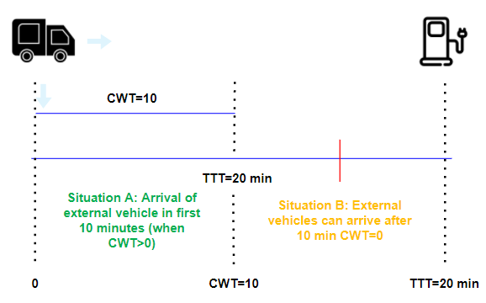


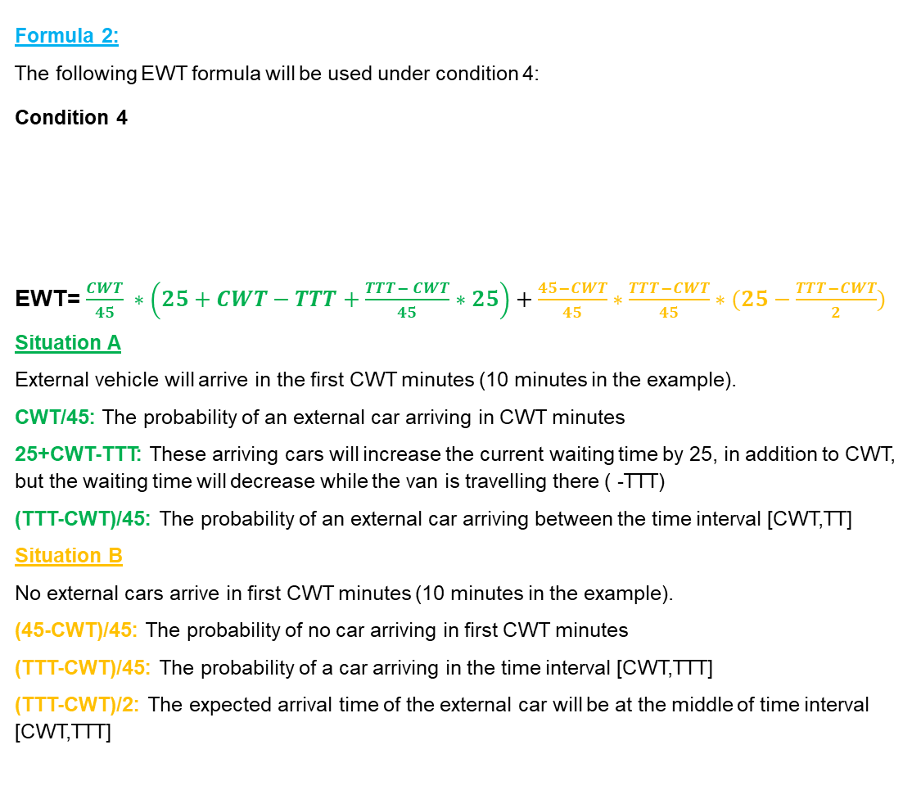
CHARGING: New Charging Policy: Charging Station Selection Probability Calculations
(Python Script 5.2)
Formula 2:
The following EWT formula will be used under condition 4:
Condition 4
EWT= $\frac{CWT}{45} ∗\left(25+CWT−TTT+\frac{TTT− CWT}{45}∗25\right)+\frac{45−CWT}{45}∗\frac{TTT−CWT}{45}∗(25−\frac{TTT−CWT}{2})$
Situation A
External vehicle will arrive in the first CWT minutes (10 minutes in the example).
CWT/45: The probability of an external car arriving in CWT minutes
25+CWT-TTT: These arriving cars will increase the current waiting time by 25, in addition to CWT, but the waiting time will decrease while the van is travelling there ( -TTT)
(TTT-CWT)/45: The probability of an external car arriving between the time interval [CWT,TT]
Situation B
No external cars arrive in first CWT minutes (10 minutes in the example).
(45-CWT)/45: The probability of no car arriving in first CWT minutes
(TTT-CWT)/45: The probability of a car arriving in the time interval [CWT,TTT]
(TTT-CWT)/2: The expected arrival time of the external car will be at the middle of time interval [CWT,TTT]
Example for Formula 2
EWT= (10/45)*(25+10-20+(20-10)/45*25) +
(45-10)/45*(20-10)/45* (25-(20-10)/2) = 8.02 minutes
Formula 3:
The following EWT formula is used under condition 5
Condition 5
EWT= 15.46
«15.46» is the average waiting time at charging stations, determined by running 1000 simulations specifically for charging stations. This value is used only when the charging station is very far away from the van, so that short-term calculations cannot be done, and we need an average waiting time to use as a proxy.
For example: TTT=100 min , CWT=5 min , EWT=15.46 min
12
12

Slide 13
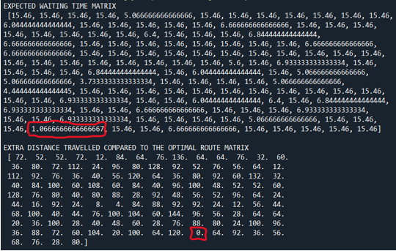
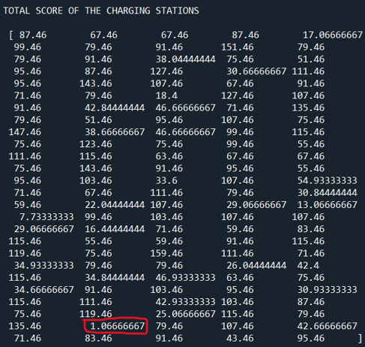
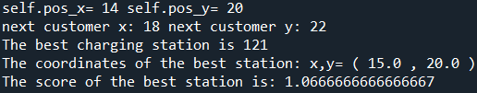
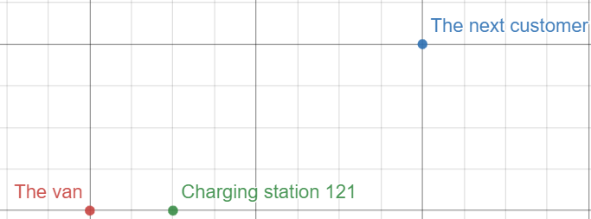
CHARGING: New Charging Policy: Charging Station Selection Output
Charging Station Score = Expected Waiting Time + Extra Travel Time= 1.06667 + 0 = 1.06667
Lets check if the calculation is correct:
Extra Travel Time (Slide 9 for example)
Charging station 121 location: (15,20)
Vans location: (14,20)
Next Customer’s location: (18,22)
Due to the charging station being located in between the van’s location and the next customer’s location, the extra travel time will be 0 , which is corrrect.
Expected Waiting Time (See slide 12 for the formula and an example)
CWT= 0
TTT=((15-14)+(20-20))/(30km/h)= 2 minutes
EWT= 2/45*(25-(2-0)/2)=1.06667
Conclusion
The van will go to Charging Station 121, which has the lowest charging station score= 1.06667
In this way, the advantage will be for the van:
Travel less extra distance
Wait less time in the queue
Even though the stochastic nature of the external cars’ arrival to the charging stations determines the real waiting times, this calculations helps making the best decision the minimize it. The performance of this new policy minimizes the waiting times at the queues, which is demonstrated statistically in slide 16.
13
13

Slide 14

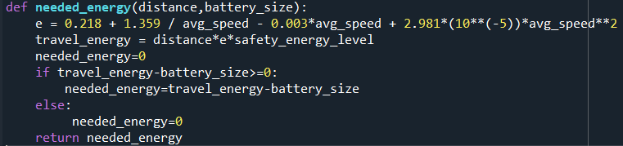



CHARGING: New Charging Policy: Charging Amount
Python Script Section 4.2
Python Script Section 5.6
When the routings are defined, total distances are recorded
Python Script Section 10
The energy is calculated by the formula provided in the base case, and using the distance data coming from the routing. Additionally, safety_enery_level is added, taken into account stochastic speed and its effect on the total energy needed.
In the class GreenModel, when the vans are created, total distance data is passed to all the vans.
Python Script Section 8
Python Script Section 8.5
Self.needed_energy is calculated by using needed_energy function, using the distance, and battery size data specific to each van. This is the extra energy needed, which is the amount of energy exceeding the battery size of a van
In the «check_charge» function of the class Van, the charging size is set to self.needed_energy
The Benefits of This New Policy
Minimize the number of visits to charging stations: By measuring the needed energy in advance (depending on the route distance determined at the start of the tour), the van will charge its battery only once with the amount of needed energy. This prevents the van from making multiple visits to charging stations.
Prevent excessive charging time: By measuring the needed energy in advance (depending on the route distance determined at the start of the tour), the van will charge battery more than it needs. In this way, it will save time.
14
14

Slide 15
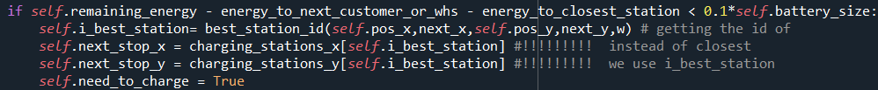
CHARGING: New Charging Policy: When to Charge?
When to start scouting for a convenient charging station?
(Early Charging Policy)
Python Script Section 8.3.1.2
Python Script Section 8.3.1.2
self.charged indicates if the van is early charged or not. When early charge is done, this value becomes 1, and no more early charge is done.
When there is enough space in the battery to charge extra needed energy, start searching for good alternatives, depending on the charging_station_score (explained in slide 10)
For example:
Total travel energy needed= 28 kwh
Battery size= 25kwh
Extra needed energy= (Total travel energy needed - Battery size) * safety = (28-25)*1.15 = 3.45 kwh
When battery level<=battery size-extra energy need=25-3.45= 21.55
So, start searching after the battery level decreases below 21.55 kwh
NOTE: This policy allows the van to early charge, so before the battery is at the critical level.
c) When the van reaches the critical battery level
Since our policy lets the van to postpone its decision of charging station selection, we need an additional policy in case of many postponements are done, and the van’s battery level is at the critical level. Therefore, when the van reaches the critical battery level (as in the base case) it will go to a charging station with the lowest charging station score.
b) Postponement of the charging station selection decision
The Benefits of This New Policy
Early Charging Policy: The van will have more chance to minimize the waiting time at the queues. Since it starts searching for good alternatives very early, it will have a bigger chance of finding a charging station with a lower waiting time, which will save time.
Postponement of the charging station selection decision: Thanks to this policy, the van does not go to a charging station immediately. If there is no good alternative available, it postpones the decision, to find a better opportunity later on.
When the van reaches the critical battery level: This policy make sures that the van will charge necessary energy if it has very little energy left. If the van postpones its decision making too many times, this policy will be a safety belt.
Python Script Section 8.3.1.2
After the van starts to calculate charging_station_score of different charging stations, if all the scores are greater than 5 (meaning that there is no good alternative), the van postpones its decision of charging, until «check_charge» function of the class van is run again.
NOTE: When the van has very little battery energy left, it will choose the best station even if all the scores are higher than 5. This is explained in section c) of this slide.
NOTE: The threshold of «5» can be changed as a managerial decision.
15
15

Slide 16


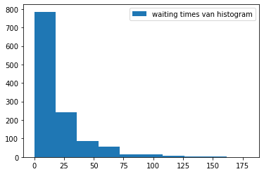
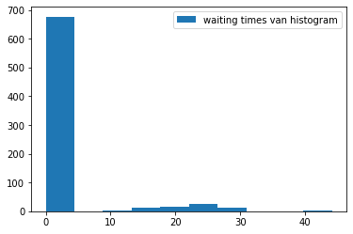
CHARGING: Base Case Charging Policy vs New Charging Policy: Performances
Having introduced the new charging policy, we should check if it improves the performance of the last mile delivery. Normally, this issue will be explained in detail in Assignment 2; however, you can see briefly the impact of this new charging policy below, statistically shown by running the simulation N times. Here, the battery sizes of the vans are decreased to 25 khw, in order to force the vans to go to charging stations, because with 35 kwh batteries the vans do not even need any charging.
Base Case Charging Policy Performance
New Charging Policy Performance
16
16
The mean waiting time at the charging station queues is 17 minutes, and more importantly, having a huge variability, occasionally causing unexpectedly huge waiting times at the queues. No doubt that this base policy is not minimizing the waiting time at the queues.
The mean waiting time at the charging station queues decreased from 17 minutes to only 2 minutes, and also with very very low variability. This clearly shows the contribution of this new charging policy to last mile delivery performance.

Slide 17
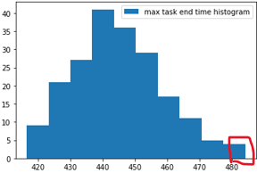
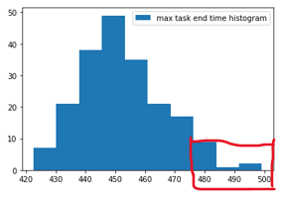

BATTERY SIZE
25 kwh
35 kwh
Base Case
Possible Managerial Applications Deriving From Flexible Battery Sizes
In the Assigment 2, usage of different battery sizes for different vans will be considered deeply. However, here we would like to briefly mention how important this aspect will be. Below, you can see how the managers can identify an opportunity to save money:
In the base case, the battery size is fixed to 35kwh. However, when using multiple vans, the vans may have different battery sizes. The company may decide using different vans with different battery sizes, due to the fact that the vans with larger batteries may cost more than the vans with smaller batteries.
Therefore, the code must be adjusted to let the decision makers set different battery sizes for multiple vans.
Max Tour End Time of Multiple Vans
Battery Sizes:[35,35,35,35]
Max Tour End Time of Multiple Vans
Battery Sizes:[30,30,20,20]
Modified Version
Python Script Section 2.2
Battery size is now an array, containing different values for different vans.
Python Script Section 8.1.1
The managers will easily identify that even with smaller batteries [30,30,20,20] all the vans can complete in 8 hours. This is an opportunity to rent cheaper vans with smaller batteries (of course if this is an option for the company). In this way, possible saving opportunites can be identified. A hypothetical business case will be solved in Assignment 2 to adress this issue.
self.battery_size and self.remaining_energy attributes are adjusted. Int(self.id_van[4:]) is getting the id of the van, since the name of the van is «van_0».
17
17

Slide 18
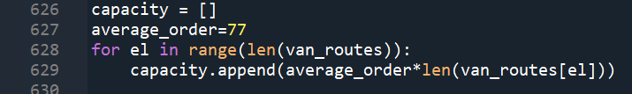
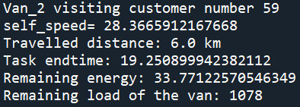
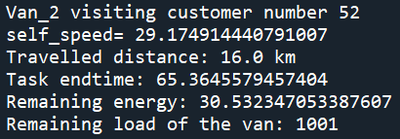
CAPACITY OF THE VANS
As mentioned in the problem each van has a limited capacity of 1.8 ton. This results in the fact that doesn’t matter the length of the routing, the company rents only a single type of van for each mission. It can be assumed that the company is renting these trucks for the problem of the assignment. In this case, this project work offers an optimization for also the renting costs of the vans. This section talks about how to calculate the required capacity for each van. With this information, analysis of the work can be done beforehand, and more suitable vans can be rented beforehand.
The cost can be optimized by calculating the load requirements of each van. Capacity requirement of each van is calculated by the following formula and the script:
Required Capacity =
#Customers Visited * Average Order Weight
capacity: an array containing the required capacity of each van
average_order : average order weight
len(van_routes): #customers visited in each routing
Each van starts their journey with full amount of load which is equal to the required capacity. One package is reduced from the van at each customer location. At the end of the journey, the van comes back to the warehouse with a loading of 0.
18
18

Slide 19


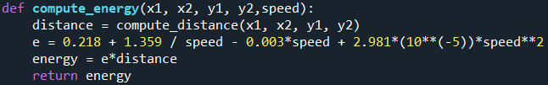





STOCHASTIC SPEED
Python Script Section 8.1.2
Python Script Section 8.4
The self.speed starts from the value 0
Python Script Section 8.3
In the «check_charge» function, the speed is updated stochastically, each time the «check_charge» function is executed.
2 already existing functions, compute_time and compute_energy, are modified to include speed as an input, being able to compute time and energy consumed depending on the stochastic speed.
Python Script Section 8.3
The Impact of the Stochastic Speed on the System Performance
Stochastic travelling time: The travelling time varies depending on the stochastic speed, making it harder to predict the tour end time of the vans. This stochasticity may force the company to increase the number of vans, in order to cope with unexpectly slow average speed. This actually represents the real world situation more realistically, in which the speed may vary according to traffic situation in that given city.
Stochastic energy consumption: As the speed of the vans are used as an input to calculate the energy used, the stochasticity of the speed also effects the energy consumption. This may effect the energy needed to complete a tour, which may force the company to have vans with bigger batteries as a safety factor.
The script allows the user to decide whether to use stochastic speed or not (stochastic_speed=1 means stochastic speed is used) also allowing the user to change the parameters of the stochastic speed (avg_speed and the standard deviation of the speed
Python Script Section 8.4
19
19
self.speed attribute is used to compute energy and time in the move function.

Slide 20

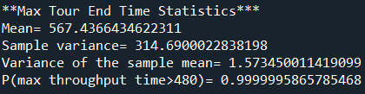
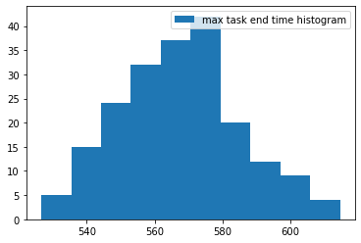


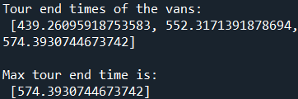
THE NUMBER OF VANS NEEDED
NOTE: This part will be deeply explained in the Assignment 2; however, here we are briefly introducing you the procedure according to which the right number of vans can be decided., since it is also required in the Assignment 1.
Objective Function: Minimize the number of vans Constraint: All vans must complete the tour in 8 hours
***Case 1*** Number of vans: 3 Battery Size: 35 kWh for all vans Charging Policy: The new charging policy Speed: Stochastic
Step 1: Data Collection
The first step is to collect the data of the maximum of the tour end times by running multiple simulations:
Tour End Times of a run:
Van_0: 574
Van_0: 552
Van_0: 439
The recorded value will be 574 minutes, which is the highest of the all tour end times. Because, our main goal is to have all our vans complete the tour in 8 hours, not the average van.
Step 2: Calculating Statistics
The statistics of max tour end times are calculated.
Step 4: Try Different Alternatives
Since 3 vans are not enough to satisfy 8 hours constraint, a different setting must be tried.
In the next slide, 4 vans will be evaluated.
Python Script Section 7.3
Case 1 Conclusion:
3 vans are not enough to satisfy 8 hours constraint
4 vans will be tried in the following slide
Python Script Section 8.4
Python Script Section 8.4
Assuming a normal distribution and making calculations, in 0.999 of the cases 3 vans are not enough to satisfy 8 hours constraint
The Output
20
Step 3: Decide Number of Vans
20
The decision maker will decide if the probability of exceeding 8 hours is acceptable or not. In this case, 3 vans are not enough to satisfy this 8 hours constraint.

Slide 21

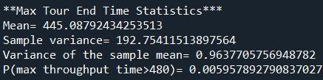

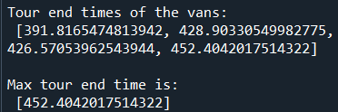
THE NUMBER OF VANS NEEDED
NOTE: This part will be deeply explained in the Assignment 2; however, here we are briefly introducing you the procedure according to which the right number of vans can be decided., since it is also required in the Assignment 1.
Objective Function: Minimize the number of vans Constraint: All vans must complete the tour in 8 hours
***Case 2*** Number of vans: 4 Battery Size: 35 kWh for all vans Charging Policy: The new charging policy Speed: Stochastic
Step 1: Data Collection
The first step is to collect the data of the maximum of the tour end times by running multiple simulations:
Tour End Times of a run:
Van_0: 452
Van_0: 428
Van_0: 426
Van_0: 391
The recorded value will be 452 minutes.
Step 2: Calculating Statistics
The statistics of max tour end times are calculated.
Step 4: Try Different Alternatives
With the given battery sizes (35 kwh for all vans), 4 vans are easily satisfying the 8 hours constraint. In this case, the battery sizes were so large for the vans that they did not even need to go any charging stations.
Here, the managers can start thinking:
«What if we use vans with smaller batteries, which are cheaper, and still can satisfy 8 hours constraint?
Python Script Section 7.3
Python Script Section 8.4
In the Assignment 2, we will solve a hypothetical business case, in which the managers will try to decide the battery sizes of the vans, which satisfies 8 hours tour time constraint, and also minimizing the daily cost of the fleet of the vans.
NOTE: The main contribution of our new charging policy will be seen in the Assignment 2. Here, due to 35kwh is a very large battery for the given routing, the vans do not need any charging at all.
Python Script Section 8.4
Assuming a normal distribution and making calculations, in 0.995 of the cases 4 vans are enough to satisfy 8 hours constraint
The Output
21
Step 3: Decide Number of Vans
21
The decision maker will decide if the probability of exceeding 8 hours is acceptable or not. In this case, 4 vans are perfectly enough to satisfy it.

Slide 22

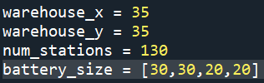
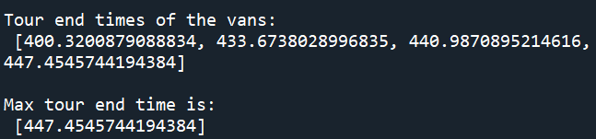
CONCLUSION
In this project work, the weakness of the given Last Mile Delivery Problem are analyzed, and possible solution methods are generated for the most important weaknesses. In the end, the problem is solved with the given constraints and the 8 hours constraint is satisfied with four vans with a very high confidence interval.
Yet, the given constraints might limit to reach the best results. In this sense, there are some issues that can be improved in the managerial part:
The first aspect is that the company might need to rent a fleet of identical vans with a battery size of 35kWh. In this case, the constraint for a van selection will be the van with the longest routing. This might be more costly than necessary. A possible solution to reduce the cost is to customize the battery size of each van. In other words, renting different types of vans. The following figure represents that it is possible to reach a solution with the same number of vans in the given time limit with vans having different (and less than the base case) battery sizes.This issue will be deepened in the Assignment 2 by solving an hypothetical business case.
The second aspect to consider is the total time assigned for each routing. Some vans come back to the warehouse a bit earlier then the other ones. This creates a discrete amount of unused capacity of these vans. This can be solved by allowing some flexibilities in time-wise on each route or by utilizing these vans for other works in those unused time-slots.
22
22

